Slide 1
Multi-IR Flame Camera Series
HIKFIRE
NOV., 2024

Slide 2
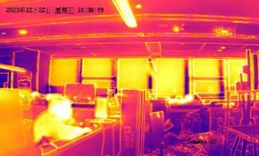
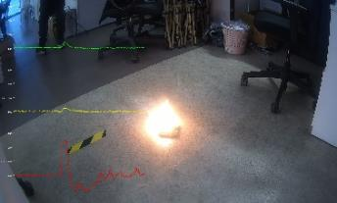
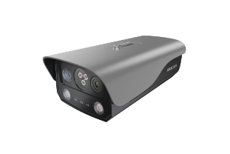
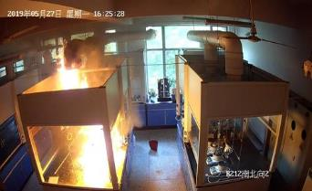
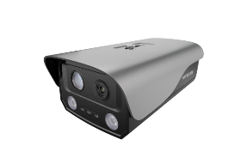
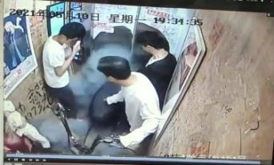
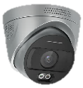
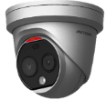
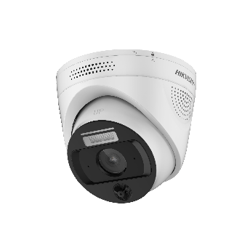
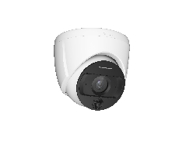
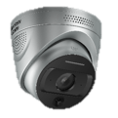
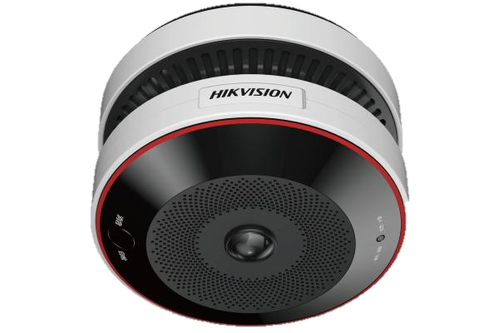
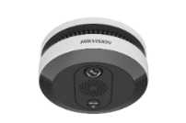
Product family: combination of image processing, heat detection, and multi-IR sensor fusion technologies to realize early fire detection
Core concepts：
1+N integrated design (AI vision + various multispectral detector)
Professional pyrotechnic deep learning algorithm based on massive industrial scene material training
Far IR heat sensing type
There is no best sensor, but only the most suitable sensor!
Multi-IR type
Price
Smoke sensing type
Heat sensing type
Non-contact heat sensing
Open flame detection
Abnormal heat
Smoke concentration
Thermal imaging + triple IR + AI smoke and fire identification
Non-contact high temperature / differential temperature alarm
Flame detection range: 50m
Multispectral review ensures accurate flame identification
Multi-band infrared pyroelectric flame detection
AI visual intelligent analysis
Flame detection range: 30m~50m
Wi-Fi, 4G optional
Smoke detector + image verification
GB20517-2006
Network access license (distribution type)
Thermopile / NTC heat sensor: high temperature / differential temperature alarm
AI visual analysis (common type)：smoke and fire identification, electric bicycle detection , on-duty status detection
【Pros】 Accurate flame detection free of interferences of high temperature, sunlight and other environmental factors;
high performance-cost ratio;
abundant communication modes and alarm interfaces can match the personalized needs of various scenarios
【Cons】 Unable to detect abnormal temperature
【Pros】Millisecond response speed to detect abnormal temperature; support thermal imaging, assist visible light AI recognition
【Cons】 Relatively high price; trigger false alarm affected by sunlight and high temperature objects; if there is a fire in the sunlight reflection area, there is possibility of missing alarm.
【Pros】 Accurate smoke detection
【Cons】 Not suitable for places with little smoke during deflagration or combustion / large spaces / outdoors
【Pros】 Cost-effective and reliable
【Cons】 Contact heat sensing type can’t identify the initial stage of fire

Slide 3
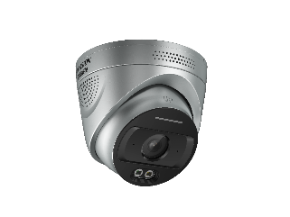
Comparison of Parameters between Products
 | HF-VR343 | HF-VR244
Sensor | Duel-IR: 4.3 um + 3.8 um | Triple-IR: 4.3 um + 3.8 um+5.0um
Detection Range | within 30 meters(0.1 m² fire pan) | within 50 meters(0.1 m² fire pan)
Professional intelligence | AI Smoke and flame detection on-duty/off-duty status, channel occupation, dangerous behaviors | AI Smoke and fire detection
Maximum image size | 2688×1520 | 2560 × 1440
Communication | Wired | Wired
Alarm interfaces | 1 input, 2 outputs | 2 inputs, 2 outputs
Audio | 1 built-in microphone，1 built-in speaker, 1 input (Line in), 2 outputs (Line out) | 1 built-in microphone，1 built-in speaker, 1 input (Line in), 2 outputs (Line out)
Protection degree | IP67 | IP67
SD card expansion | Support（256GB） | Support（128GB）
Reverse power supply | Support | ×
Sensor Ad Hoc network | DC12V reverse power supply | ×

Slide 4
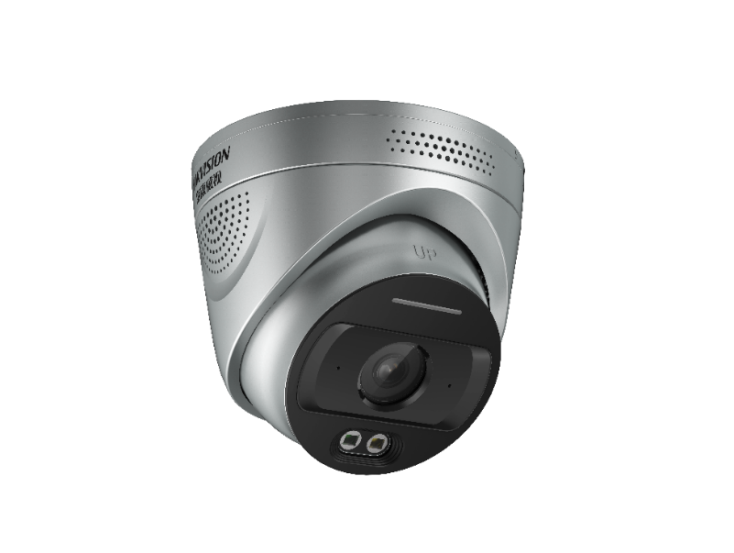
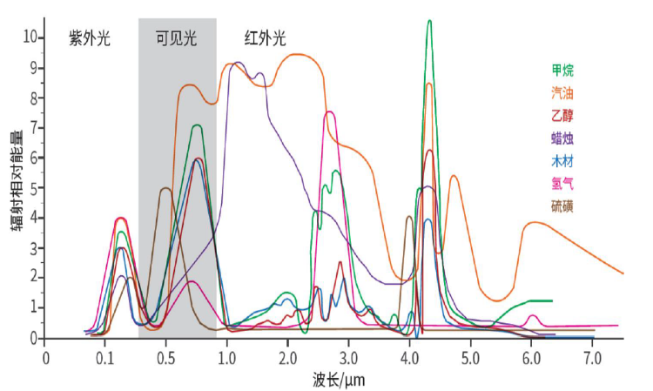
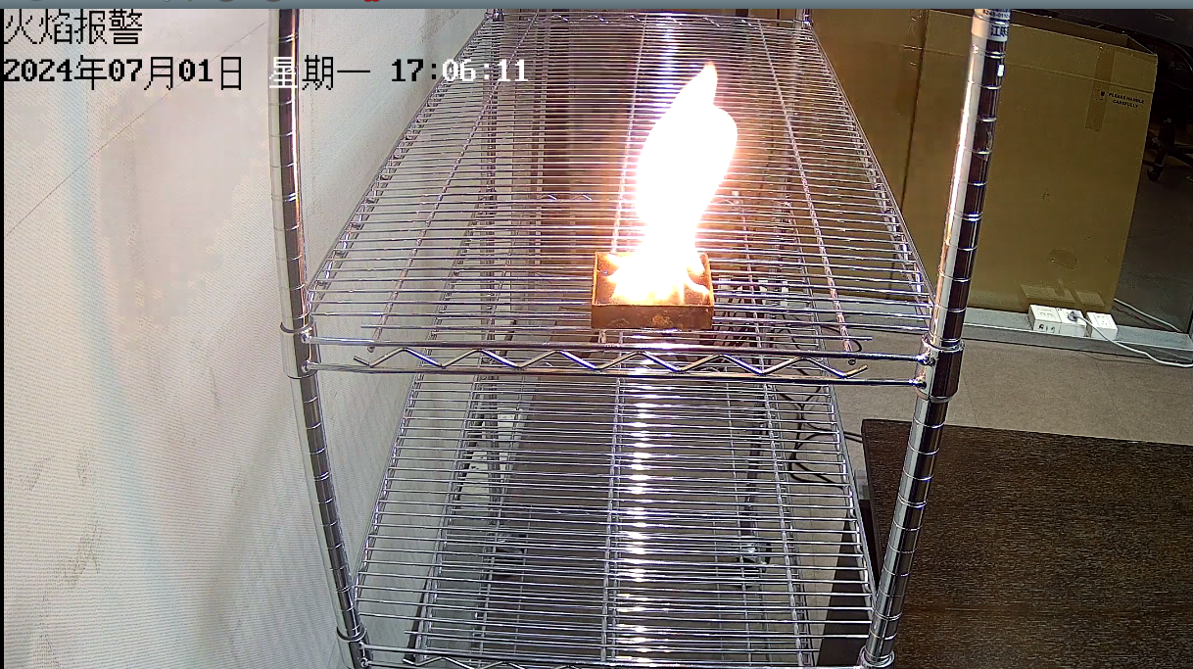
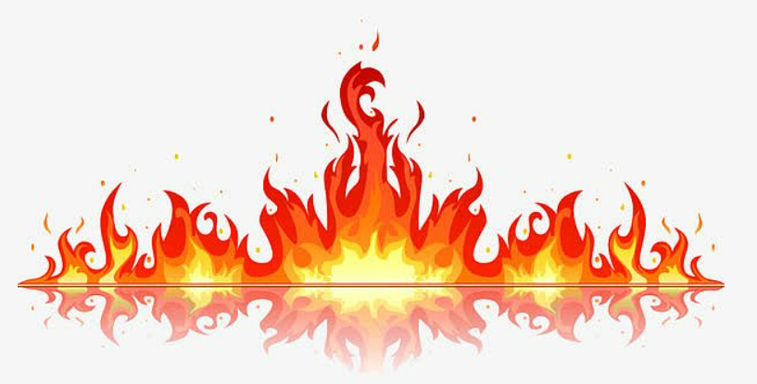
Multi-IR flame detection
Flame Identification
Using multi-IR infrared pyroelectric sensor and AI deep learning algorithm, the ambient temperature around the sensor can be detected in real time.
Detection range: 100 ° cone (covering visible lens), 30m/50m detection range (0.1 ㎡ fire pan)
CO₂ radiation in the 4.3um band
IR flame detector
Fire check model:
True flame only
100° ultra wide detection angle
Detect time：in 5s
Organic combustion detection rate ： 99%
Not affected by sunlight spots and high temperatures in summer
5.0um ref band
3.8um ref band
IR flame detector
30m/50m
0.1 ㎡ fire pan

Slide 5
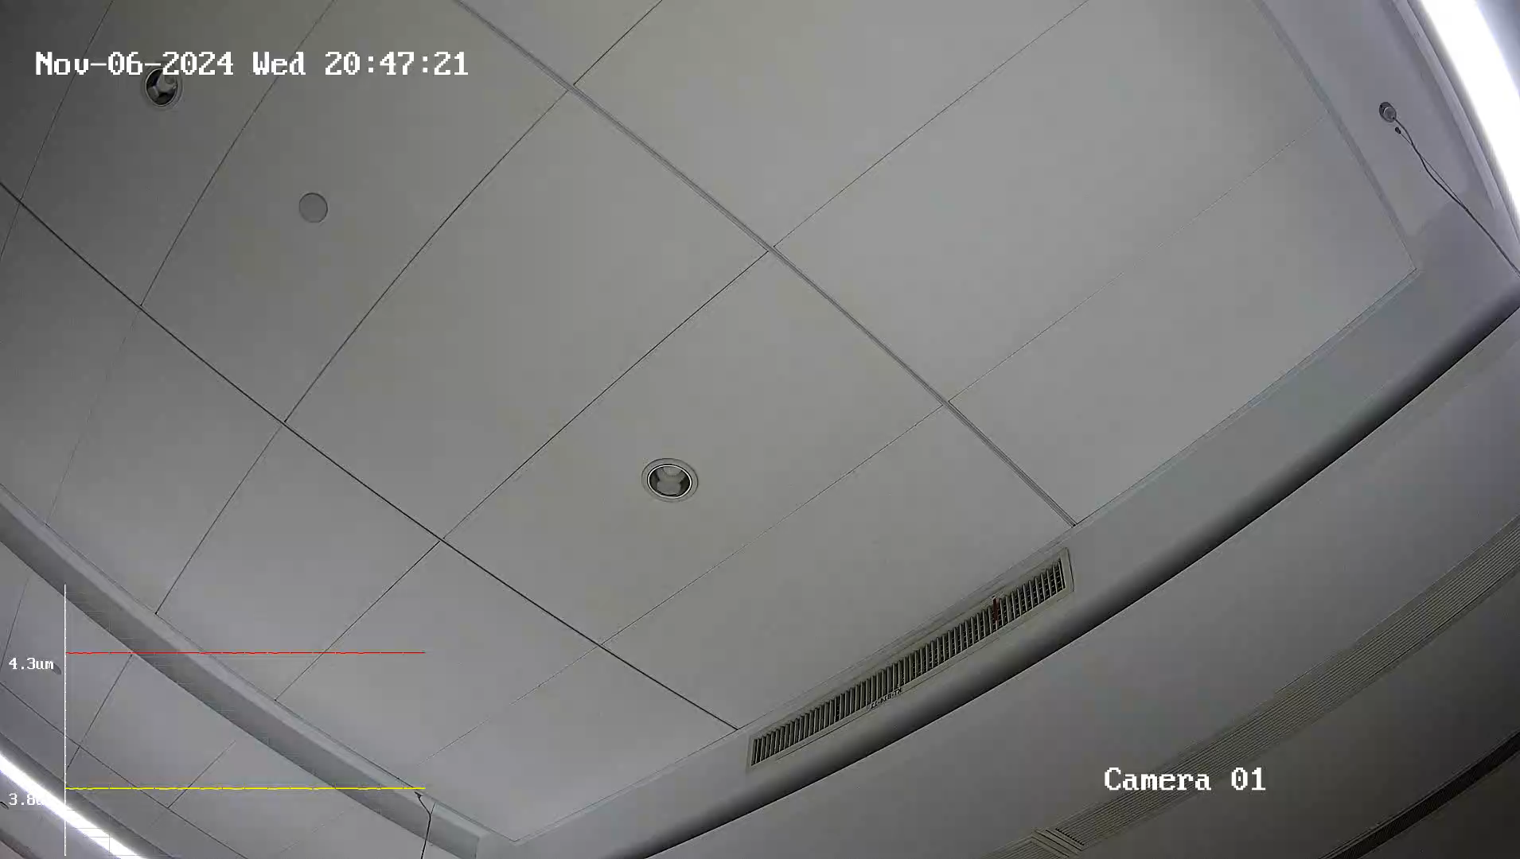
Video Demo
Multi-IR Sensor

Slide 6

AI Algorithm Warehouse
For HF-VR343
Intelligence
Algorithm
1.5T surging computing power, creating a super strong end-to-end security and consumer integrated detector, allowing AI intelligent recognition to break through performance limitations and achieve more than just a little bit of accuracy!
100% Computing Power Performance
Smoke Detection Algorithm
Smoke Detection
On/Off Duty
50%
20%
10%
20%Free
10+ Al algorithms dynamically loading
On-demand configuration

Slide 7
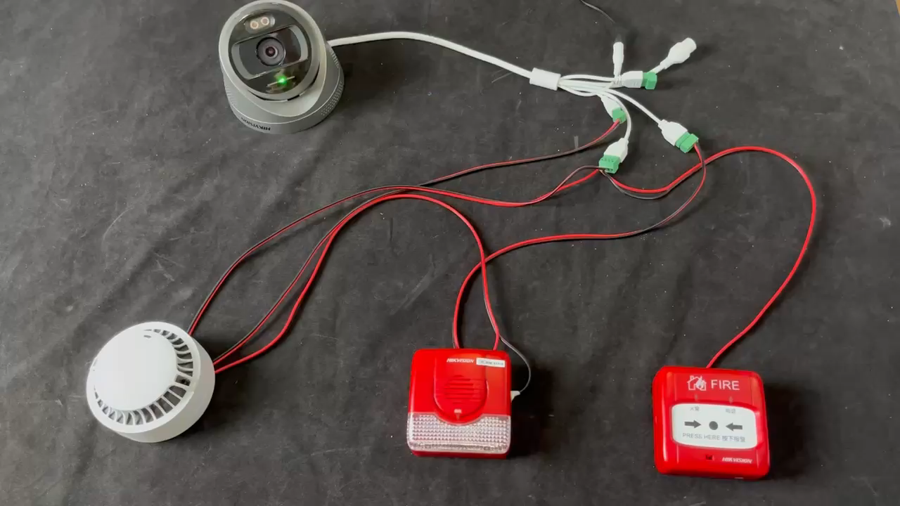
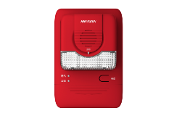
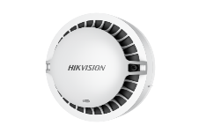
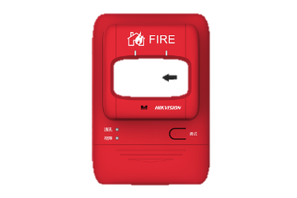
Reverse Power Supply
For HF-VR343
Interface design
1 input & 2 outputs isolation design, strong anti-interference ability, maximum output of alarm up to DC30V / 1A.
Built-in Hi-Fi microphone and speaker, support two-way voice intercom.
Support up to 256G TF card local storage expansion.
Reverse power supply for perception expansion
Sound & light alarm bell
Detector of smoke / gas / …
Supports DC12V reverse power supply for four-bus smoke detectors power at the same time,as well as CO detectors, standalone gas detectors, etc.
*Suggest purchasing smoke detectors and alarm bells locally

Slide 8
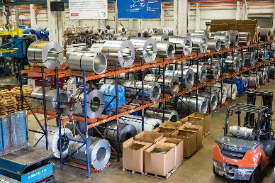
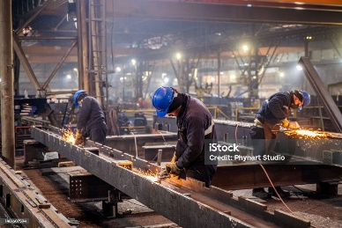

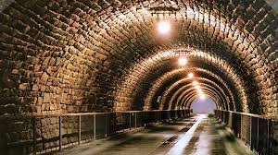

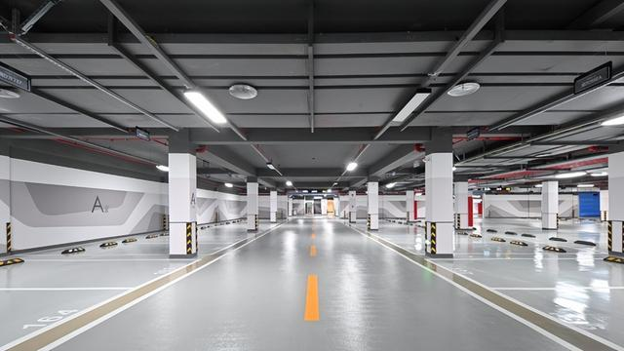
Application Scenario
“Ordinary camera + fire monitoring” two-in-one product
-- aimed Flame sensitive, avoiding false alarm by temperature changes
This series identifies changes in infrared signals and image characteristics of flames in the monitored area, achieving early fire warning and alarm, as well as remote visual verification of fire scenes.And is widely used in warehouse, charging station, tunnel, basements, construction fields.
Warehouse
Manufacturing factory
Construction Field
Tunnel
Charging Stations
(Outdoor)
Basement

Slide 9




海康消防 公众号
海康消防 视频号

